Slide 1

ANLY 506 Lecture 3
Sourcing Data, Databases, and SQL

Slide 2
Lecture Outline
Sourcing Data (continued)
Data source examples
Intro to R
Data Structures
Reading in data locally
Reading in data from URL
Databases and SQL
Relational data model
SQL language

Slide 3
Sourcing Data

Slide 4
Steps in the EDA Pipeline
Discovery
Research Design
Data
Search
Analysis
Pre-Processing
Processing/Analysis
Results
Conclusions

Slide 5
Data Sources
Kaggle.com – Data and competitions
Data.world
Github.com
UCI Machine Learning Repository
http://archive.ics.uci.edu/ml/index.php
Forbes 2016 list
https://www.forbes.com/sites/bernardmarr/2016/02/12/big-data-35-brilliant-and-free-data-sources-for-2016/#781feb32b54d

Slide 6
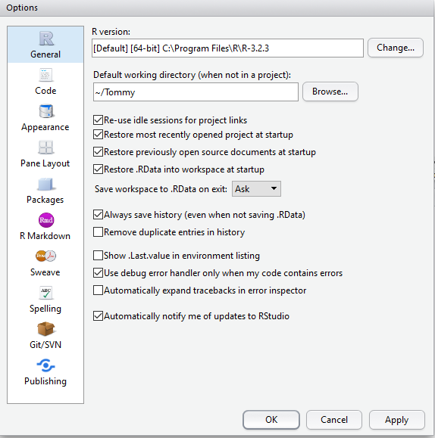
Getting Started – Set Default Working Directory
Go to Tools>Global Options
Under Default working directory hit Browse and select the folder you would like
Restart R Studio
To temporarily change the working directory later, use setwd(“path”), replacing all / with //

Slide 7
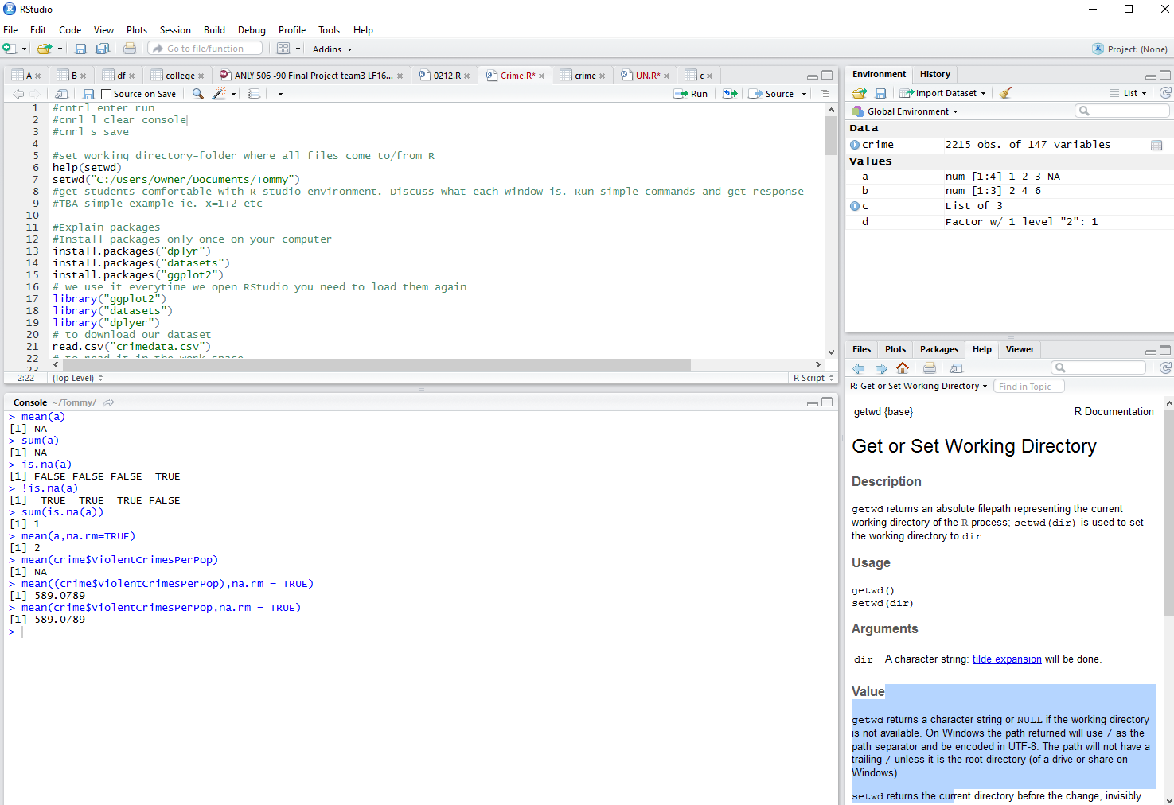
Script: will run most commands from here
Global Environment/Workspace: All defined Data and Values will appear here
Console/Log: Displays commands which have been run. Can also run commands directly in console.
Here you can see files, plots, packages (libraries), and the help view.

Slide 8
Getting Started – Examples
Use either = or <- for the assignment operator
R is case sensitive
To create a vector use c(value1, value2, … n)
A few simple examples
X <- 3 #assign X the value 3
X = 3 #same as previous line
vector = c(1, 2, 3, 4) #define a vector
vector2 = vector*2 #scale the vector
Y = max(vector2) #assign m to the max of vector 2 (8)
Z = “This is a string” #assign Z to a string
Z == Y #returns a Logical/Boolean (FALSE)

Slide 9
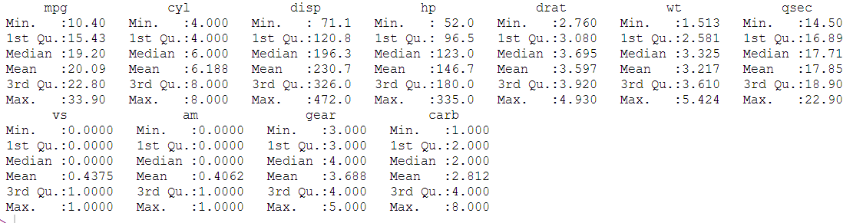
Built in Datasets in R
View all built in datasets in R
data ()
Read in data from built in dataset
data(mtcars)
The dataset will appear as a dataframe once it's used
summary(mtcars)

Slide 10
Data Structures
Delimeter = character which separates values in data
Name | Age | Weight
Jim | 20 | 140
Bob | 32 | 180
Name,Age,Weight
Jim,20,140
Bob,32,180
Standard representation
CSV representation
.csv - Comma Separated Value – Variables are separated by commas
.txt - Text file – Variables can be separated by many types of delimeters
.xlsx – Excel file – Can include extensive fomatting and calculation information. This information is not retained when importing to R or other languages

Slide 11
Importing Local Data with R
Read csv file
Dataset includes many features of houses which can be used to predict their value
houses = read.csv ("houses.csv")
Only read in first 100 rows
houses2 = read.csv ("houses.csv",nrows=100)
Read txt file
Dataset includes attributes of songs which can be used to predict which year the song was released
music = read.table (“music.txt", sep=“ ”)
Only read in first 100 rows
music = read.table (“music.txt", sep=“ ”, nrows=100)

Slide 12
Importing Local Data with R (cont.)
Read xlsx file
“xlsx” package and many others require Java.
Download java here: https://java.com/en/download/
Install xlsx package if not already installed
if(!require("xlsx")){install.packages("xlsx")}
Load package
library(xlsx)
Read xlsx file, 2nd argument is sheet number
housesFromExcel = read.xlsx2 ("housesExcel.xlsx", 1)

Slide 13
Importing Data from URL with R
Read csv from url
fires = read.csv (url ( “http://archive.ics.uci.edu/ml/machine-learning-databases/forest-fires/forestfires.csv” ) )
Only read in the first 100 rows
fires = read.csv (url ( “http://archive.ics.uci.edu/ml/machine-learning-databases/forest-fires/forestfires.csv” ) , nrows=100 )

Slide 14
Databases and SQL

Slide 15
Databases
Database- Organized collection of data
Database Management System (DBMS) – Computer application which allows the definition, creation, querying (searching), update, and administration of databases
Relational DBMS (RDMS) - The most common DBMS, built using the relational data model

Slide 16
Relational Data Model
Tables in RDMS = Dataframes in R
Rows are observations
Columns are variables
Number of rows is same for all columns
Keys are used to identify and link data
Primary Key − Uniquely identifies each row/record in a database table
Foreign Key − Uniquely identifies a row/record in any another database table

Slide 17
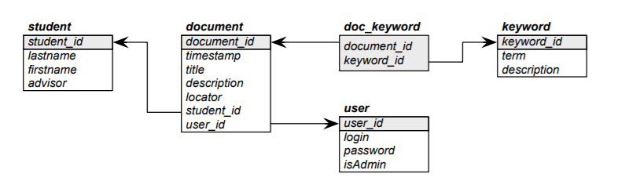
Relational Data Model
Each box above represents a separate table, with the variables displayed.
Primary keys for each table are highlighted in gray (student_id is a primary key for the student table)
Foreign keys for each table are shown with arrows (student_id is a foreign key for the document table)

Slide 18
SQL
Computer programming language designed to run queries for RDBMS
Most widely used database language
Can be integrated with R using sqldf package

Slide 19
SQLDF
sqldf(“select vars from dataset where logical condition is met)
vars – list variables or use * for all
dataset – name of dataset in R
Logical condition – Conditions which subset the data

Slide 20
SQLDF
Install sqldf package if not already installed
if(!require("sqldf")){install.packages("sqldf")}
Load package
library(sqldf)
Select all variables (* = all) with mpg >20
sqldf("SELECT * FROM mtcars WHERE mpg > 20")

Slide 21
Read in data with SQLDF
Read in a subset of a csv using sqldf
expensiveHouses =
read.csv.sql ("houses.csv", sql="select * from file where SalePrice < 200000", eol="\n")

Slide 22


